Slide 1

TTECHS IT Services Services menu
TTECHS.LIVE

Slide 2
Agenda
01
02
03
Explore IT support service offerings
Understand managed IT service benefits
Learn about data center colocation
04
05
06
Discover cybersecurity and incident management
Review Voice over IP solutions
Outline web development and procurement

Slide 3
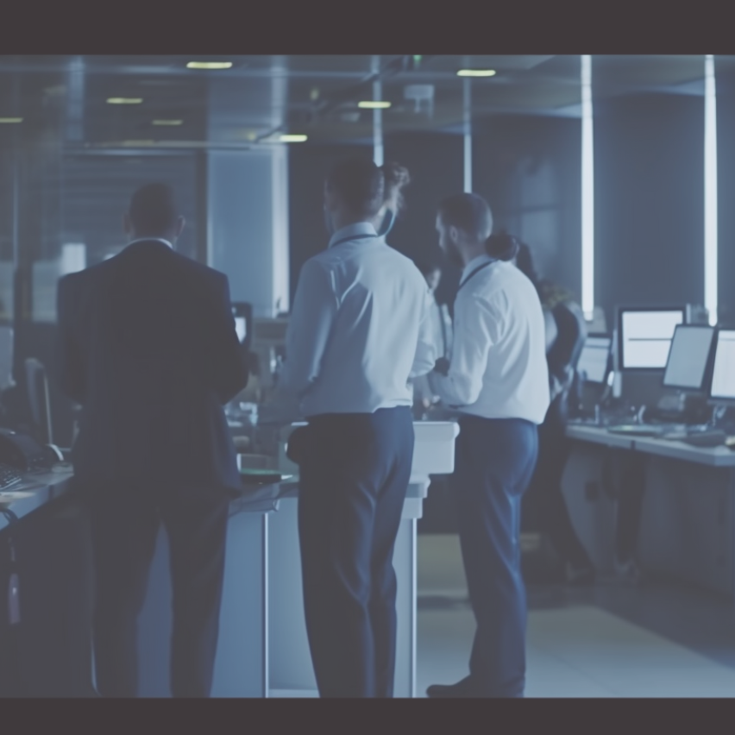
Introduction to TTECHS IT Services
IT Support
01
Our experts provide comprehensive IT support for troubleshooting and ensuring all your technical issues are resolved efficiently, so your business operations remain uninterrupted.
Managed Services
02
We proactively manage your IT infrastructure, maintaining security and performance while you concentrate on growing your business without the worry of technology failures.
Colocation Benefits
03
Utilize our secure data center colocation for hosting your hardware, ensuring it remains operational with remote support for increased reliability and reduced overhead costs.

Slide 4
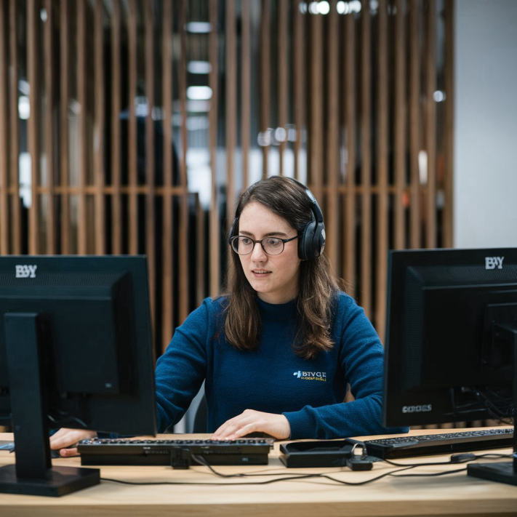



Our Mission and Vision
Vision
Mission
Values
To be the leading IT service provider for businesses in the Atlanta Metropolitan area.
To provide exceptional IT support that empowers businesses to focus on their core operations and growth.
Integrity, customer-centric approach, and commitment to excellence in all our IT services.

Slide 5

Overview of IT Support Services
Support
01
Our team provides Tier 1, 2, and 3 support to address issues efficiently and effectively.
Management
02
We manage your user access and identity to ensure security and authorized system access.
Resolution
03
Our troubleshooting services include resolving software, email, and printing issues for end-users.
Device
04
We support peripheral and mobile devices to ensure seamless operation and security.

Slide 6




Desktop and End User Support
01
90%
Of users report improved productivity with effective support.
3 days
Average time for issue resolution is reduced significantly.
02
70%
Of support queries are resolved within first contact.
4 hours
Time saved for users due to efficient support responses.
03
80%
Of customers satisfied with our IT support services.
2 months
Faster onboarding process with structured IT support.
$50,000
1 vendor
Consolidated support simplifies management and reduces costs.
04
Annual savings estimated with proactive IT management.

Slide 7
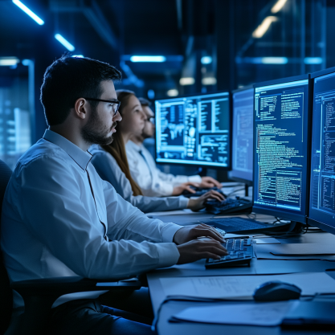
Access and Identity Management
User Access
01
Establish strict controls on user permissions and access levels.
Security Audits
02
Regularly perform audits to identify and resolve security vulnerabilities.
Multi-Factor Authentication
03
Implement multi-factor authentication to enhance user account security.
Password Policies
04
Enforce strong password policies to prevent unauthorized access.
05
Incident Response
Develop a clear incident response plan for quick action during breaches.

Slide 8
Peripheral and Mobile Device Management
01
02
03
04
Device Security
Printer Services
Management Efficiency
Device Updates
Ensures authorized access for mobile devices.
Quick resolution for printers and peripherals issues.
Streamlines operations for seamless user experience.
Keeps systems current with latest updates.
Action Sequence
Assess Devices
Implement Security
Monitor Performance
Review Management
Evaluate current devices for functionality.
Establish protocols for device security.
Track device performance and user issues.
Regularly assess management strategies and updates.

Slide 9
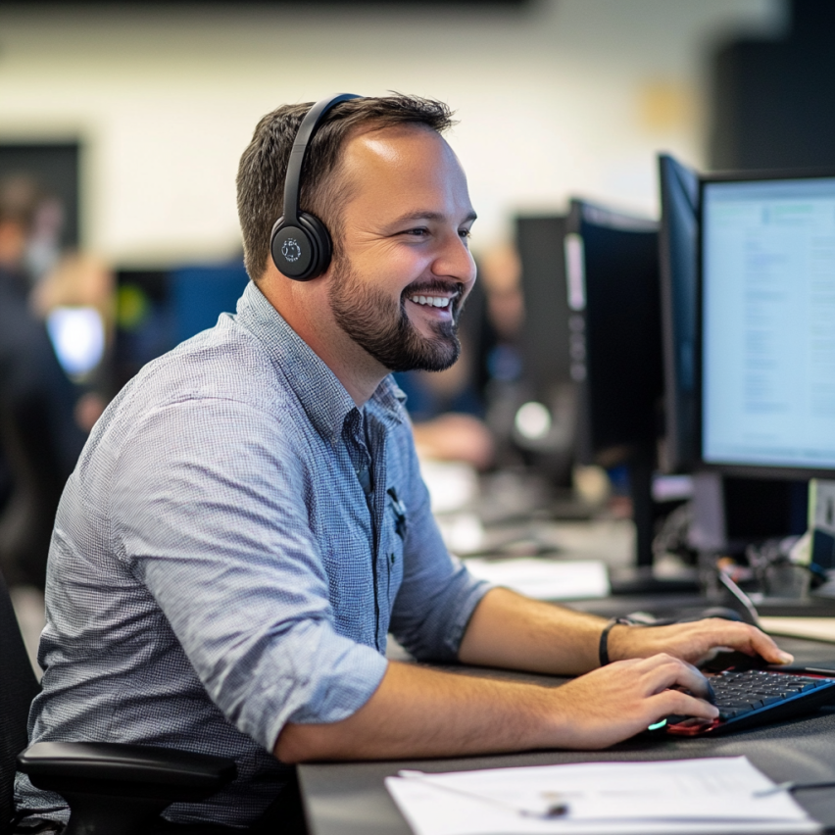
Introduction to Managed IT Services
Security
01
Proactively protect your business from cybersecurity threats with expert consulting and incident response management.
Infrastructure
02
Simplify management of both on-premises and cloud infrastructures for a more efficient business environment.
Support
03
Gain access to 24/7 IT support ensuring seamless operation and minimal downtime for your business.
Monitoring
04
Implement continuous network monitoring to quickly identify and resolve potential issues before they escalate.

Slide 10
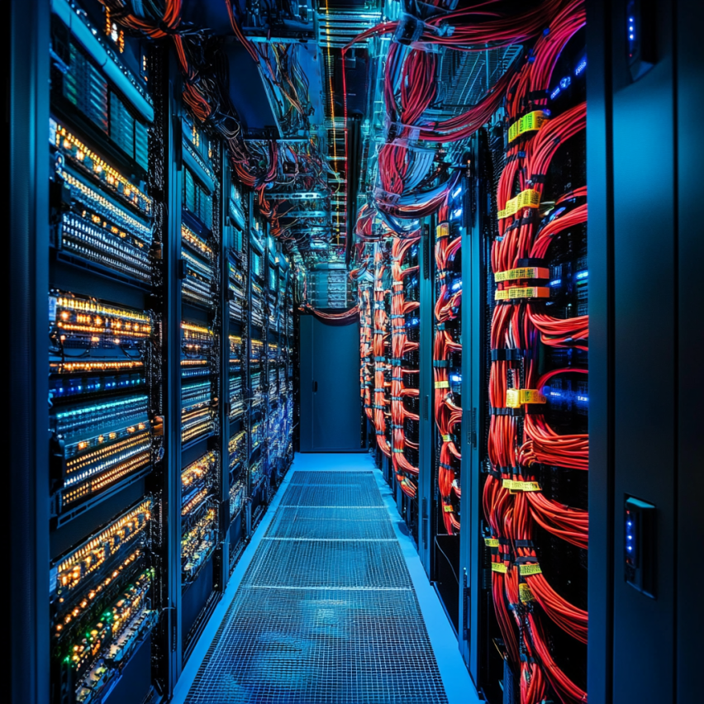
Infrastructure Management Overview
Cloud Integration
01
Seamlessly integrate your existing systems with cloud solutions for enhanced flexibility and scalability.
Infrastructure Monitoring
02
24/7 monitoring of your IT infrastructure ensures prompt identification of issues, minimizing downtime.
Cost Efficiency
03
Optimize resources and reduce costs through effective management of your on-premises and cloud assets.
Compliance Assurance
04
Ensure your infrastructure adheres to industry regulations and standards for data security and privacy.

Slide 11
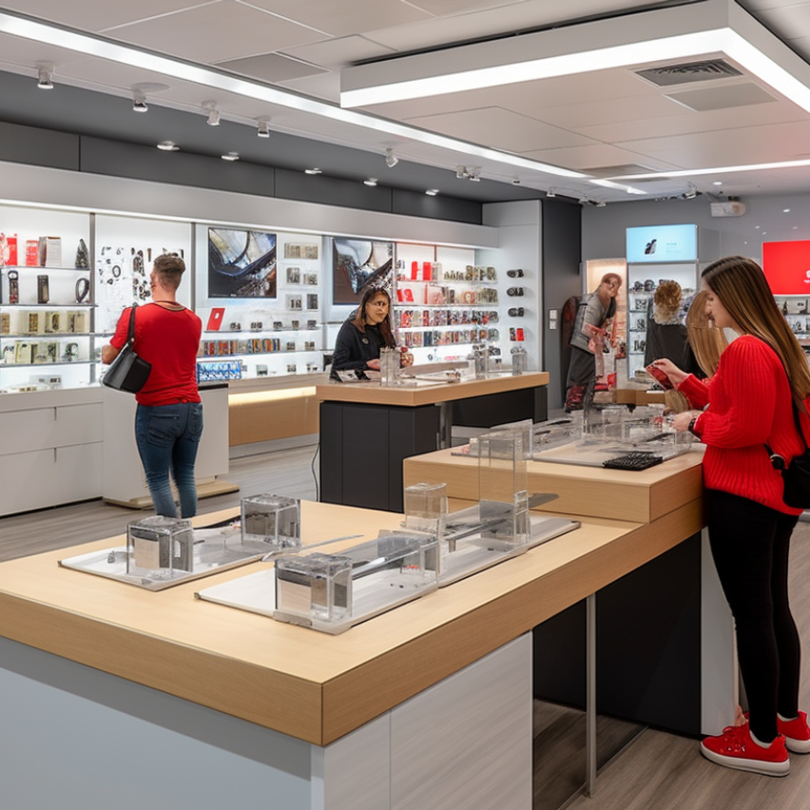
Cloud Services Support and Solutions
Security
01
Implement advanced security measures to safeguard your data against unauthorized access and potential breaches.
Scalability
02
Utilize cloud infrastructure to quickly scale your resources based on your business needs and demands.
Backup
03
Ensure data integrity by regularly backing up your information in secure cloud storage solutions.
Collaboration
04
Enhance team collaboration with cloud-based tools that facilitate seamless communication and project management.

Slide 12

Network Management Strategies
Monitoring
01
Continuous network monitoring helps identify potential issues before they impact business operations significantly.
Security
02
Implementing robust security measures ensures that your network is protected from unauthorized access and potential breaches.
Troubleshooting
03
Effective troubleshooting practices allow for quick resolution of network issues, minimizing downtime and maintaining productivity.
Optimization
04
Regular network optimization improves performance and efficiency, ensuring reliable service and user satisfaction.

Slide 13
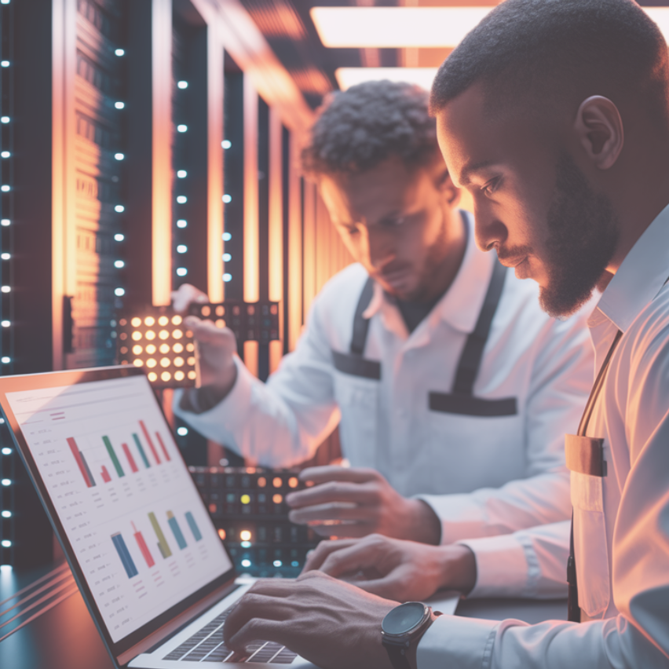
Data Center Colocation Explained
Cost-effective
01
Hosting your hardware at our data center reduces costs associated with maintaining an on-site facility, while benefiting from our secure and managed environment.
Scalability
02
With our colocation services, you can easily expand your infrastructure as needed without the hassle of physical upgrades or moving equipment.
Expert support
03
Enjoy 24/7 technical support for your hosted equipment, ensuring maximum uptime and quick resolution to any issues that may arise.

Slide 14
Hardware Hosting Solutions
Cost Savings
01
Lower overhead costs by utilizing our secure data center, which minimizes the need for your own physical hardware and maintenance expenses.
Enhanced Security
02
Benefit from advanced physical and cybersecurity measures in our data center, ensuring your hardware and data are protected from unauthorized access and potential threats.
Remote Accessibility
03
Maintain seamless access to your hosted hardware with our remote support services, ensuring downtime is minimized and your operations remain uninterrupted.

Slide 15
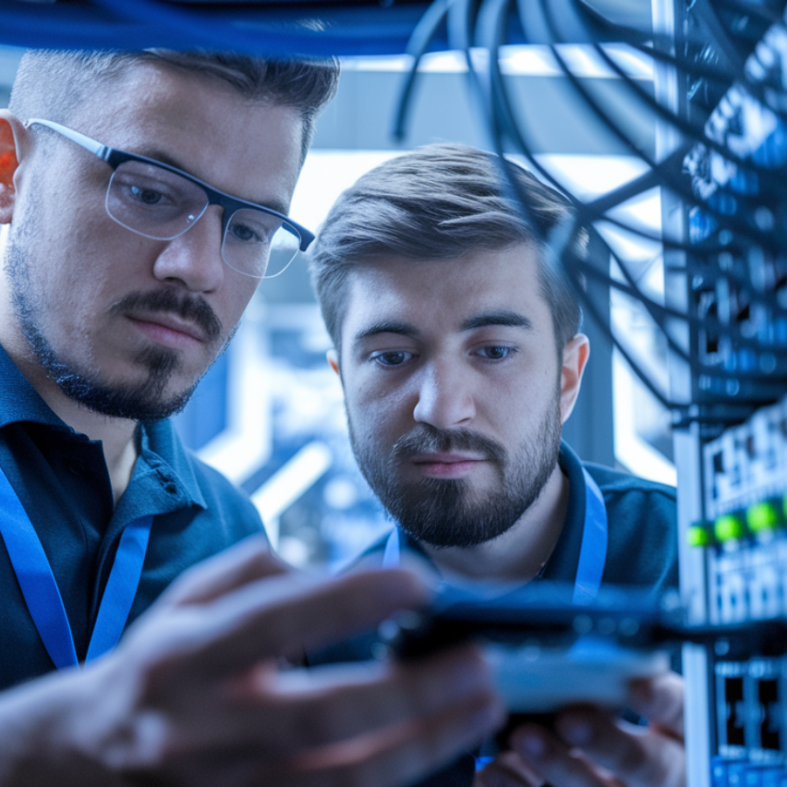
Remote Support Capabilities
Quick Response
01
Our remote support ensures fast resolution of IT issues without the need for onsite visits.
24/7 Availability
02
We offer round-the-clock remote assistance to address urgent issues at any time of day.
Secure Access
03
We utilize secure connections to manage and troubleshoot your systems while maintaining data privacy.
Cost-Effective
04
Remote support reduces operational costs associated with travel and time spent waiting for onsite visits.

Slide 16
Specialized Services Overview
Cybersecurity
01
Protect your business from potential cyber threats with our comprehensive security assessments and incident responses.
VoIP Solutions
02
Transform your communication system with our advanced VoIP technology for improved call clarity and efficiency.
Web Development
03
Create engaging and professional websites tailor-made for your business needs, improving your online presence.
IT Procurement
04
Streamline your equipment acquisitions by letting us manage the procurement process, ensuring cost-effective solutions.

Slide 17
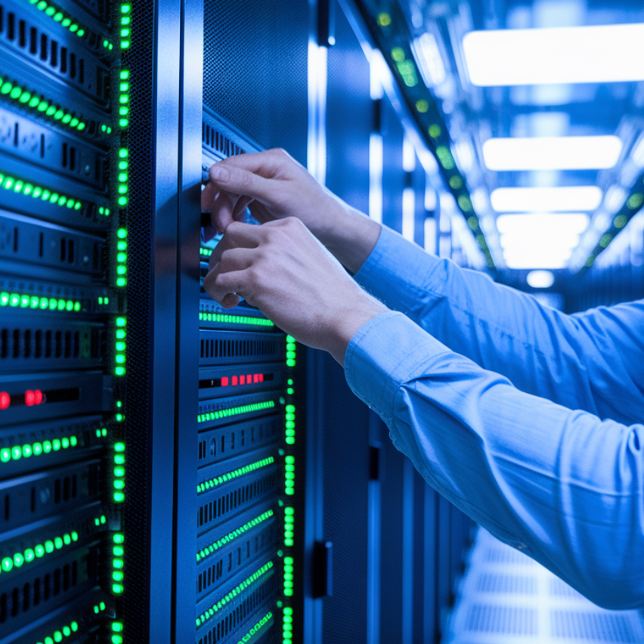
Cybersecurity and Incident Management
Risk Assessment
01
Conduct regular risk assessments to identify vulnerabilities and implement proactive measures to mitigate potential threats.
Incident Response
02
Develop an incident response plan that outlines roles, responsibilities, and procedures for swiftly addressing security breaches.
Employee Training
03
Provide ongoing cybersecurity training for employees to raise awareness of potential threats and educate them on best practices.
Security Audits
04
Perform regular security audits to evaluate the effectiveness of existing security measures and make necessary improvements.

Slide 18
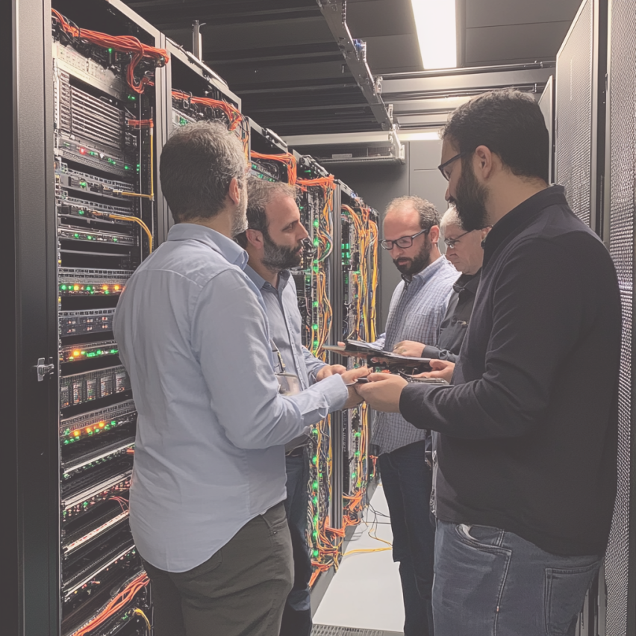
Implementing Voice over IP Solutions
Cost Savings
01
VoIP solutions significantly reduce communication costs for businesses by eliminating traditional phone line expenses and offering flexible pricing packages tailored to various needs.
Scalability
02
Easily scale your VoIP system based on business growth or changing needs, allowing you to add or remove lines without extensive infrastructure adjustments.
Enhanced Features
03
Benefit from advanced features like call forwarding, voicemail-to-email, and video conferencing that are often included in VoIP packages, enhancing overall communication capabilities.

Slide 19
Web Development Services Offered
Design
01
We create user-friendly interfaces that enhance the overall user experience for your website.
Development
02
Our team builds responsive websites that adapt to all device types for better accessibility.
Maintenance
03
Regular updates and troubleshooting to ensure your website remains functional and secure over time.
SEO Optimization
04
We implement strategies to improve your website's visibility on search engines for increased traffic.

Slide 20
IT Procurement Process Simplified
Cost Efficiency
01
Our procurement process ensures that you receive competitive pricing for the best IT equipment available.
Vendor Management
02
We handle relationships with multiple vendors to provide you with a seamless procurement experience.
Customized Solutions
03
Tailored IT purchases based on your specific business needs, enhancing operational efficiency.
Timely Deliveries
04
We prioritize quick turnaround times, ensuring you receive your hardware and software when needed.

Slide 21
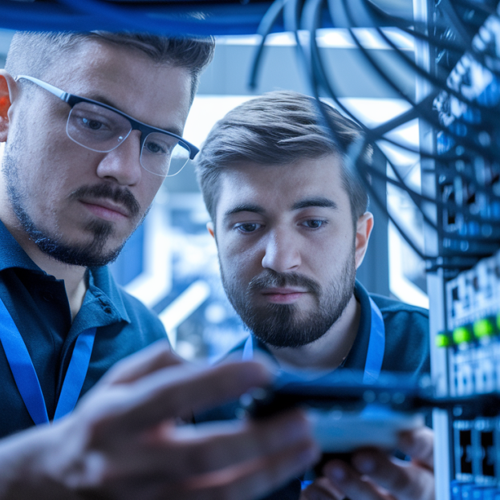
Benefits of Comprehensive IT Solutions
Increased Efficiency
Streamlined operations improve productivity and reduce downtime for your team.
01
Enhanced Security
02
Proactive measures protect your data from threats and unauthorized access.
Cost Savings
03
Reducing the need for in-house staff lowers overall IT operational costs.
04
Scalability Options
Flexible services allow your IT infrastructure to grow alongside your business.

Slide 22
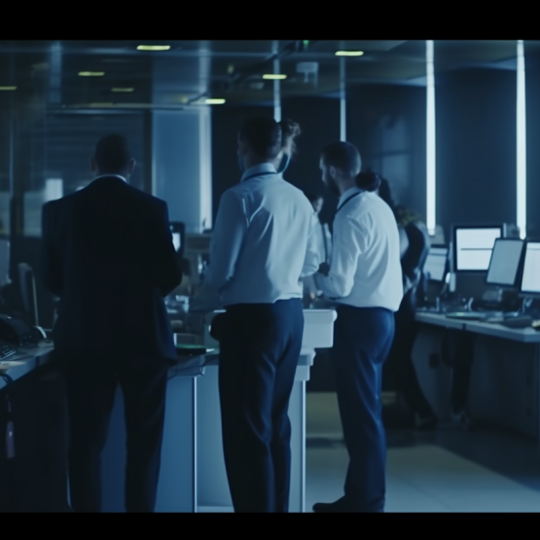



Case Studies of Success
Problem Faced
Solution Offered
Benefits
Inefficiencies in IT support and management.
Comprehensive managed IT services and support.
Improved operational efficiency and reduced downtime.
Approach
01
02
03
04
Assess
Plan
Implement
Monitor
Evaluate current IT infrastructure and issues.
Develop a tailored IT management plan.
Execute solutions based on the plan devised.
Continuously monitor systems for performance and issues.

Slide 23

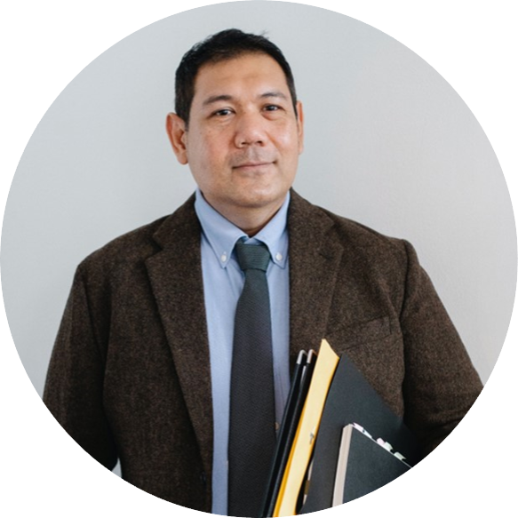




Customer Testimonials and Feedback
Alice
Bob
Cathy
David
TTECHS IT Services transformed our business operations with exceptional support.
Their cybersecurity solutions have greatly improved our data protection efforts.
The IT procurement process was seamless and very efficient with TTECHS.
I appreciate the quick response times and knowledge of the IT team.

Slide 24

Industry Trends in IT Services
Cloud Computing
01
Companies are increasingly moving to cloud solutions for scalability and reduced infrastructure costs.
Cybersecurity Focus
02
Businesses are prioritizing cybersecurity investments to protect against growing threats and data breaches.
Remote Work
03
With the rise of hybrid work models, IT services are adapting to support remote environments effectively.
AI Adoption
04
Artificial Intelligence is being integrated into IT services for enhanced automation and efficiency.

Slide 25
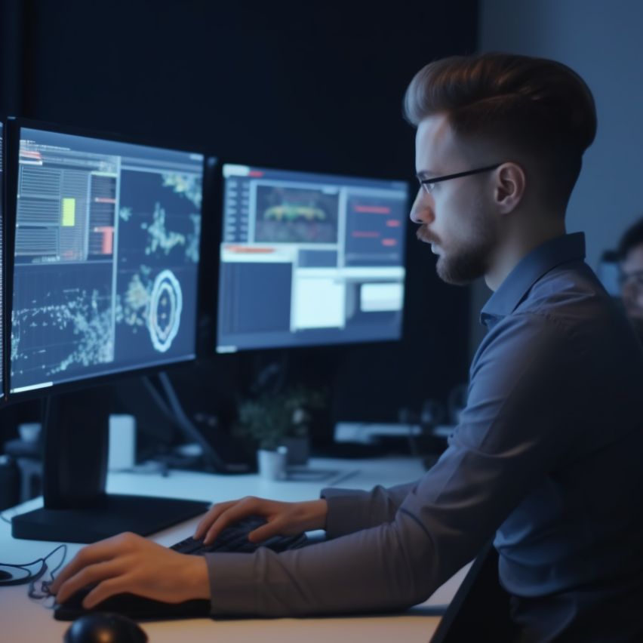
Aligning Technology with Business Goals
Efficiency
01
Streamlined processes through technology improves productivity and reduces operational costs for your business.
Security
02
Implementing cybersecurity measures protects sensitive data, providing peace of mind and compliance with regulations.
Scalability
03
Our managed services allow businesses to scale technology solutions according to growth and operational needs.
Support
04
Comprehensive IT support ensures minimal downtime and quick resolutions for technology-related issues.

Slide 26
Measuring Success Through KPIs
Customer Satisfaction
Current System Uptime
85
50%
25%
75%
Response Time
2 hours
0%
100%
Incident Resolution
Technical Support Completion Rate
90
0%
26%
100%
Network Downtime
Project Delivery On-time Rate
1%
0%
26%
100%
This is a sample dashboard. Please edit the metrics according to your message.

Slide 27
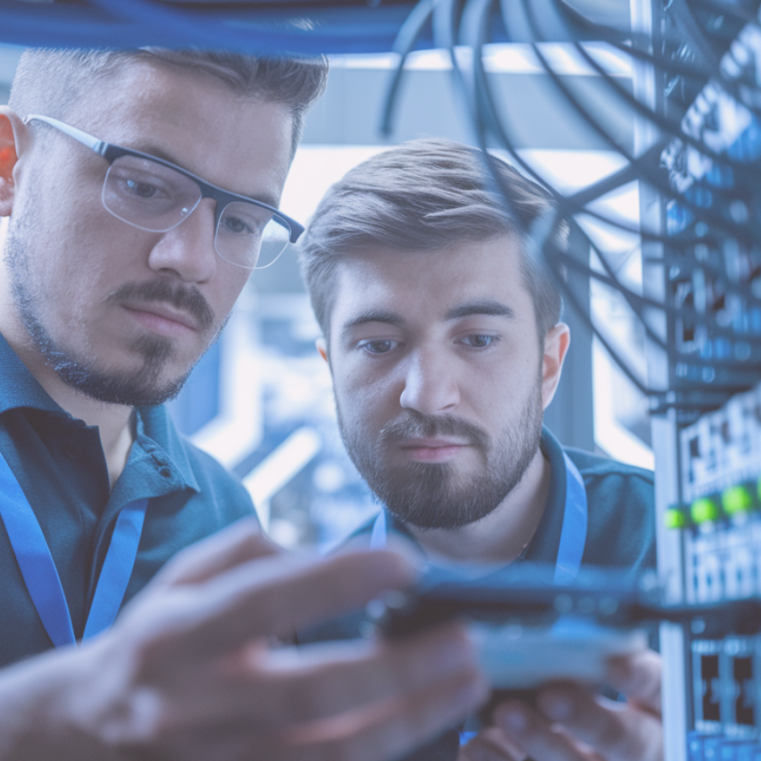
Future Trends in IT Services
AI Integration
01
Leveraging artificial intelligence to automate routine IT tasks can enhance efficiency, reduce errors, and enable faster response times in IT support and management services.
Cloud Solutions
02
Adopting cloud-based platforms will improve scalability and flexibility for businesses, allowing for increased collaboration and cost-efficiency in managing IT infrastructure.
Remote Work
03
Supporting remote work will necessitate advanced cybersecurity measures and robust IT support to ensure employees have secure and reliable access to necessary resources from any location.

Slide 28

Summary and Next Steps
Comprehensive IT Support
Providing Tiered support for all your technology needs every step of the way.
Proactive Managed Services
Ensuring your IT infrastructure remains secure and operates optimally with our management.
Secure Data Center
Offering dedicated hosting and remote support for your critical hardware and systems.
Specialized Offerings
Expanding business capabilities through cybersecurity, VoIP, and web development services.

Slide 29




Thank You
Address
1040 Founders BLVD, Athens GA 30606
Contact Number
470-3022997
Email Address
mnsimire@ttech.live

